Slide 1
Cafe Billiing System

Slide 2
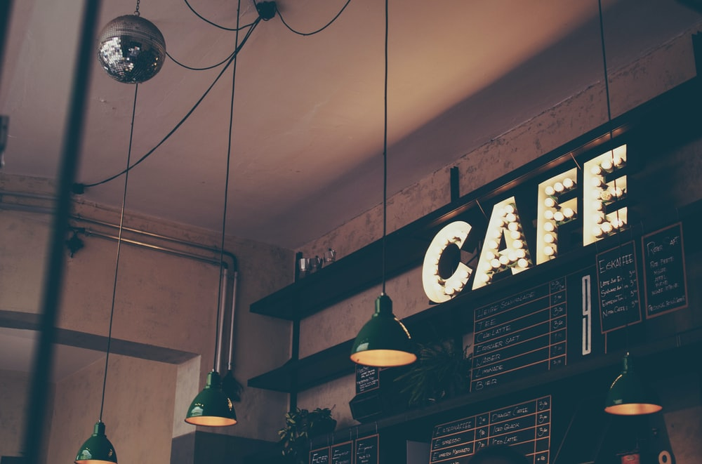

Slide 3
GROUP MEMBERS
Priyanka Sahebrao Baste (185103)
Priyanka Sunil Jadhav (185122)
Gayatri Sanjay Jaware (185123)
Pooja Sukalal Patil (185137)

Slide 4
Introduction
Cafe Billing System is a Python program that can compute the total bill of a customer digitally. This program was built using only Python language. The system contains a simple GUI application that use tkinter framework. The user can only enter the quantity of an items ordered by the customers.
The system can display the list of item price when clicking the PRICE button, and also when the item is ordered it generate the total bill of the purchase item by clicking the TOTAL button. The order no is auto generated after purchase.
We have provided a calculator for the customer, in case the person has some budget calculations to make.

Slide 5
Why Python?
Python works on different platforms (Windows, Mac, Linux, Raspberry Pi, etc).
Python has a simple syntax similar to the English language.
Python has syntax that allows developers to write programs with fewer lines than some other programming languages.
Python runs on an interpreter system, meaning that code can be executed as soon as it is written. This means that prototyping can be very quick.

Slide 6
THE IMPLEMENTED DATABASE
The name of the database is Bill.db
We have implemented a database that stores-
Reference number of the bill,
Date and time the order was made by the customer,
Total bill amount of the order made

Slide 7
FEATURES IN THE APPLICATION
We have used GUI and Tkinter in our application
Tkinter is the standard GUI library for Python. Python when combined with Tkinter provides a fast and easy way to create GUI applications. Tkinter provides a powerful object-oriented interface to the Tk GUI toolkit.
Creating a GUI application using Tkinter is an easy task.
Frames have been used to divide the screen into parts.
Labels have been used to display the data.
Grid has been used for placement.

Slide 8
The modules that have been imported are:
import sqlite3
from tkinter import *
import random
import time
import datetime
import numbers
from tkinter import messagebox

Slide 9
BUTTONS USED
We have used 4 buttons:
Total Price: Calculates the bill amount
Create Bill: Creates the bill details
Reset: Enables the refreshment of the order to start a new order
Exit: Leaves the application

Slide 10
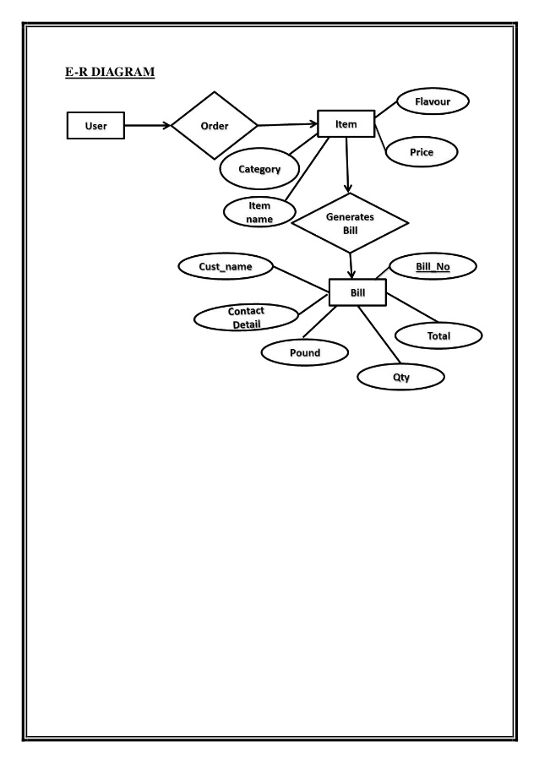
ADMIN
DATABASE

Slide 11
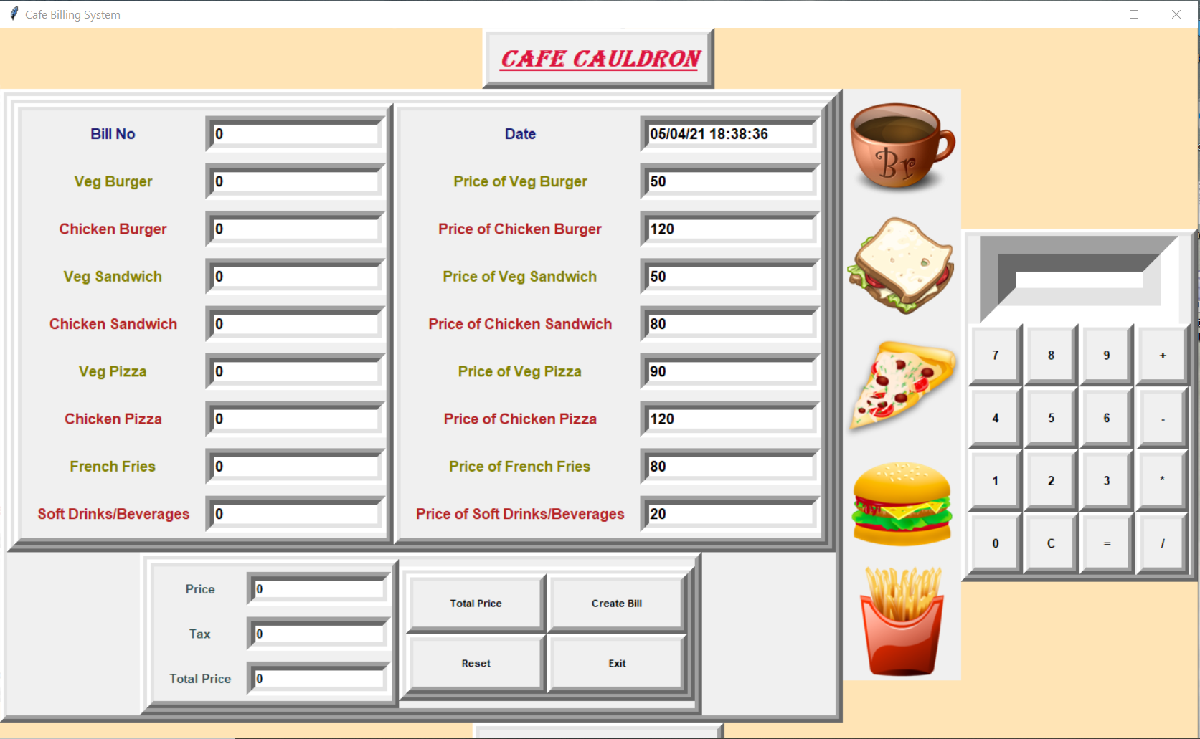
Output image

Slide 12
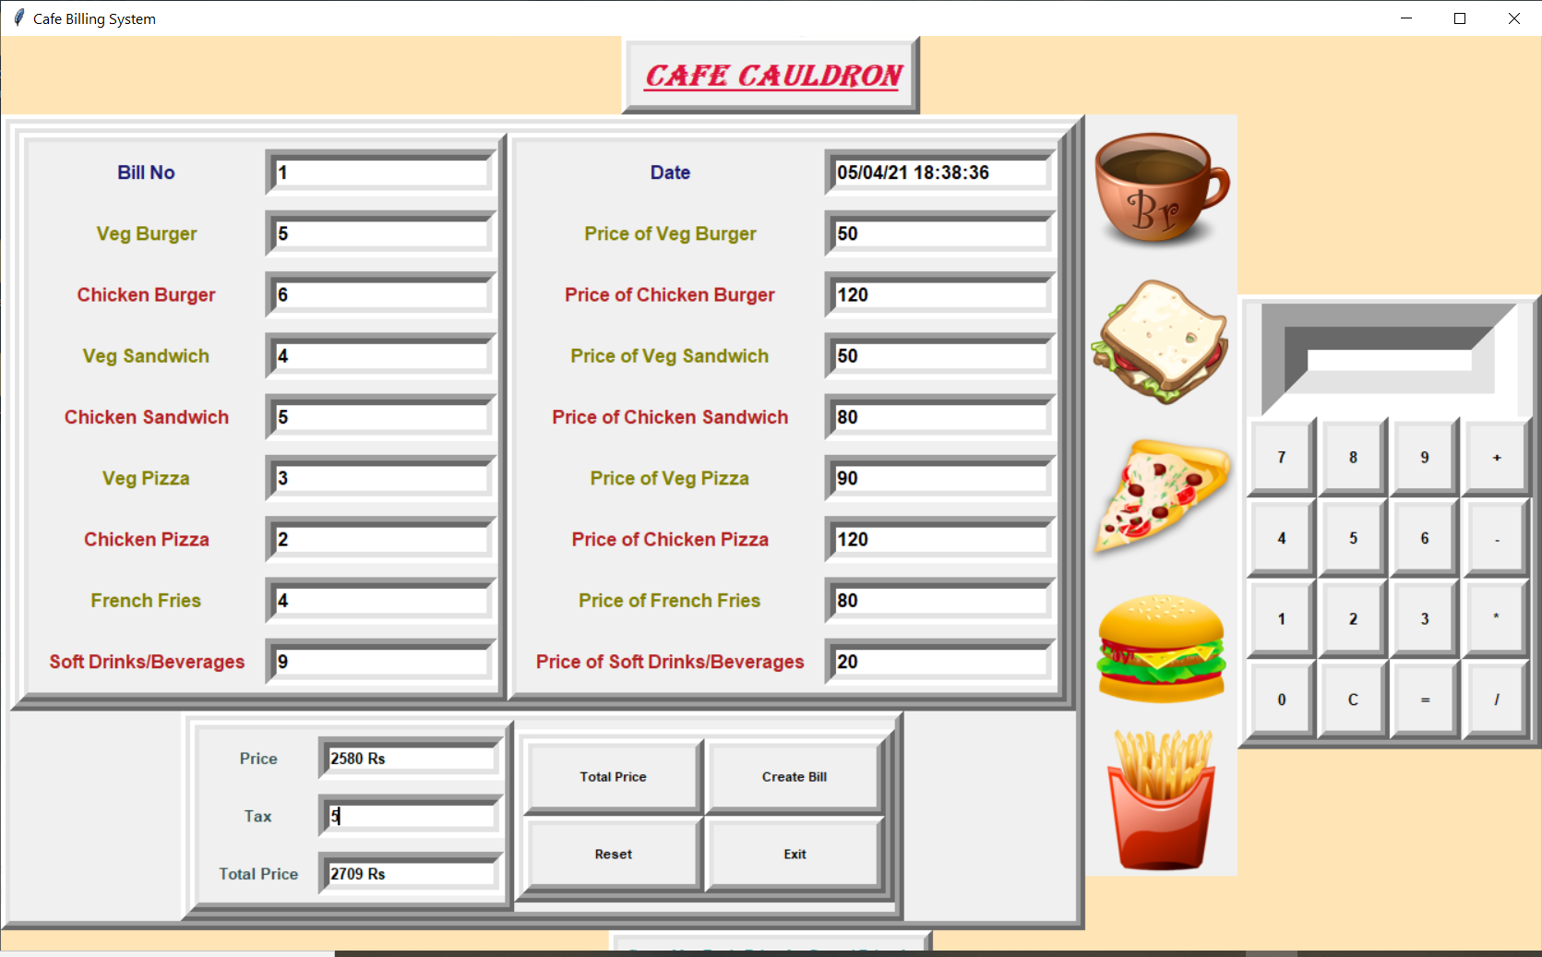

Slide 13
Hardware & Software Requirement
Processor | Core 2 Dual or more
RAM | 1, 2 GB or more
HDD | 500 GB / 1 TB or more
OS | Window 7 or Later
Database | MS Access 2003

Slide 14
Conclusion
The outcome of all the time hard work is here. We have a system which takes the necessary choice of the customers according to the filter like category of the food.This is achieved through an easy to use graphical interface menu options. The users can add any number of items to the cart from any of the available food Categories.
Customer according to the choice pay bill via cash or debit card or credit card method. Hence all the process works perfect, full filling of demand.

Slide 15
Thank You…

